Slide 1



NEXUS
Cloud Accounting Platform
Team Members
CSE1 - SGP
D22DCS141 - Viral Gautami
D22DCS149 - Raj Bopaliya
D22DCS154 - Anjan Lunagariya
Guided by
Prof. Mohini Darji

Slide 2
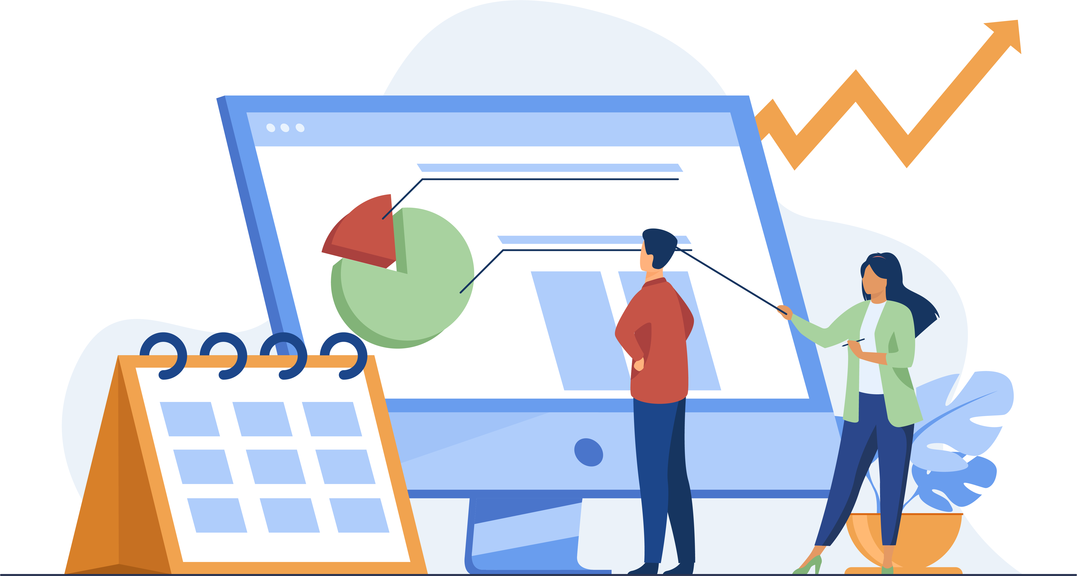
NEXUS
Cloud Accounting Platform
Table
Of Content
Introduction
What is the MERN stack?
Our project goals
Challenges and solutions
Advanced features explored
Conclusion

Slide 3

NEXUS
Cloud Accounting Platform
Project Focus
Why MERN Stack is Cool:
- We're here to talk about our project – a website for Managing Business.
- We used something called the MERN stack, a powerful mix of technologies.
- The MERN stack is MongoDB, Express.js, React.js, and Node.js – tech tools that help us build websites.
- Our project shows off the cool things you can do with the MERN stack.
- This stack is super popular because it's good at making websites fast and strong.
- It's made up of four parts: MongoDB, Express.js, React.js, and Node.js.
Project Goal:
Introduction
- Our goal is to show how the MERN stack's fancy features can make Accounting dashboards on the web.
- We want to teach everyone how to use these cool features to make really good websites.
- This is important so we can stay ahead in the tech world and make clients happy.

Slide 4
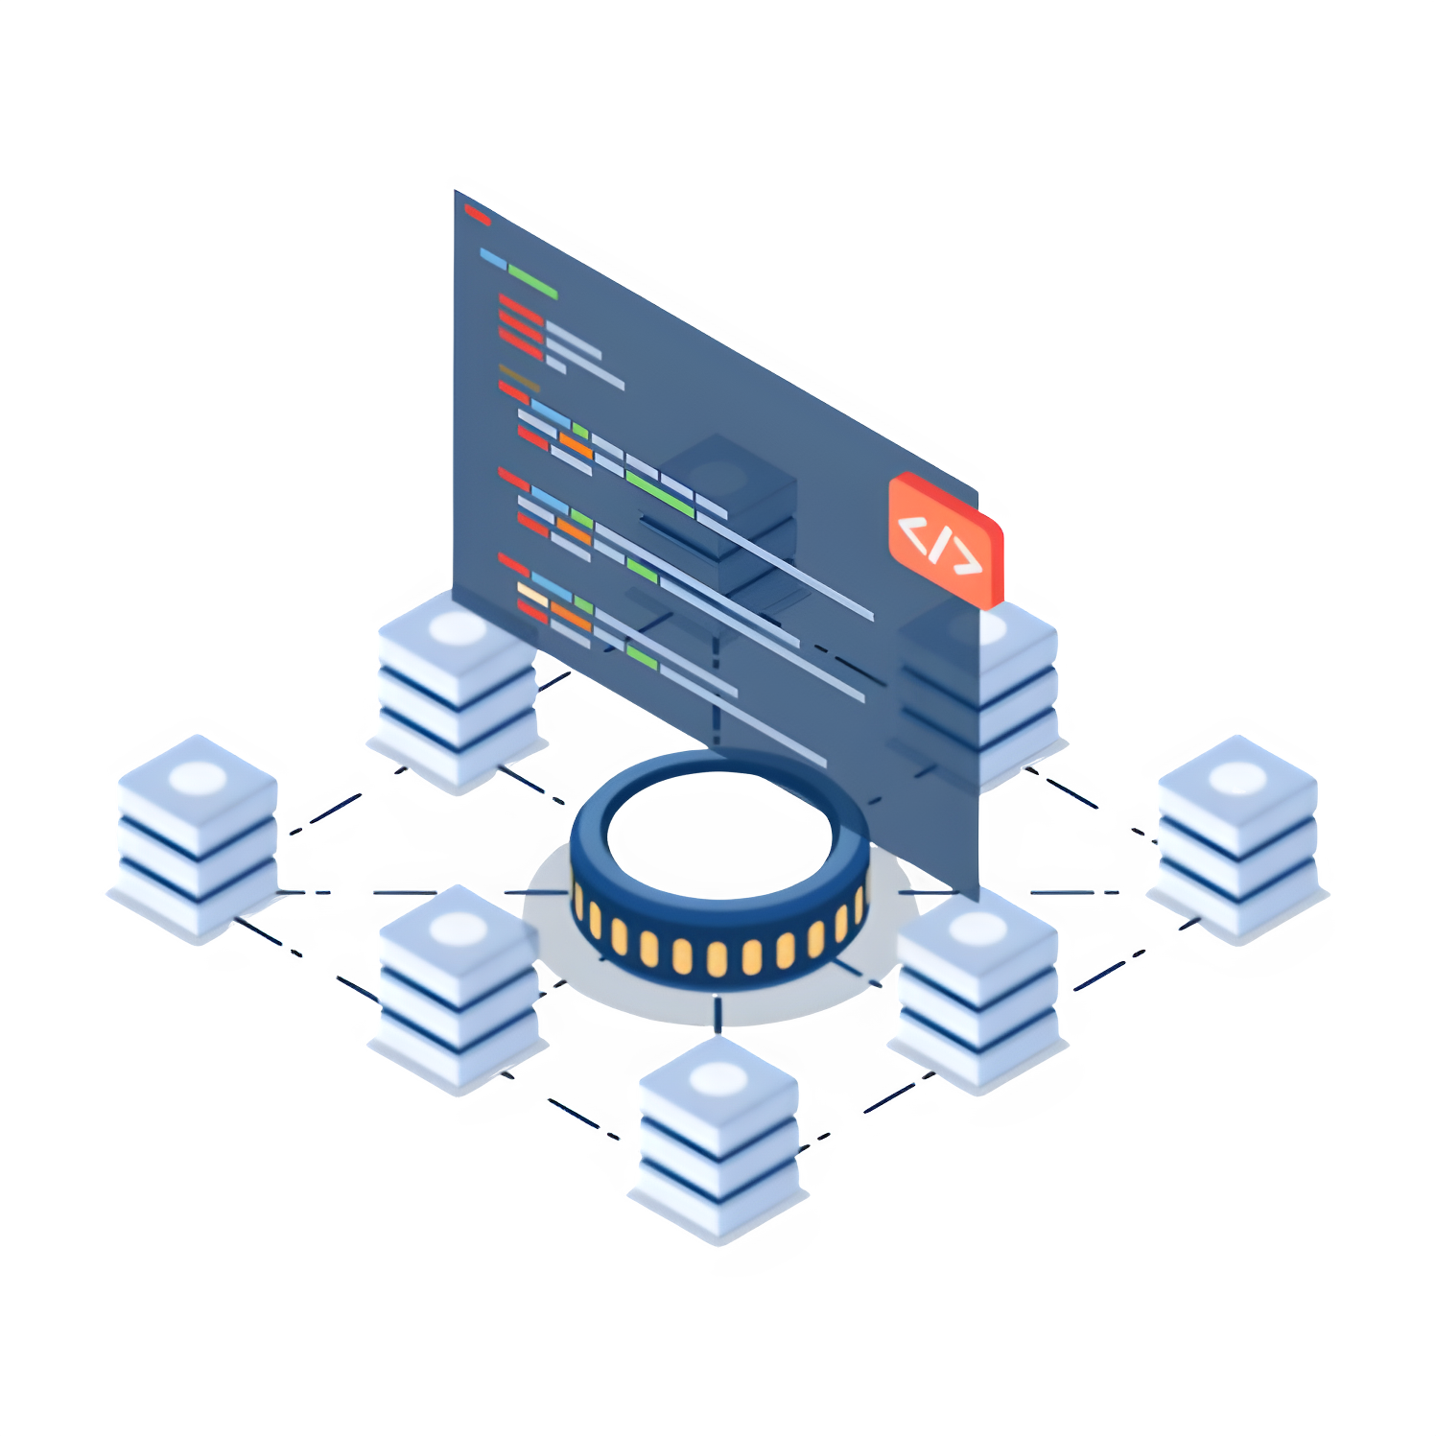
NEXUS
Cloud Accounting Platform
What is the
MERN stack?
MERN STACK
- The MERN stack is a popular way to build websites, and it's made up of four main technologies: MongoDB, Express.js, React.js, and Node.js.
- What makes the MERN stack special is that it uses the same programming language, JavaScript, for both the part of the website that you see (front-end) and the part that works behind the scenes (back-end).
- This makes things easier for developers because they only need to learn one language for the whole process, which saves time and makes it simpler to keep things working well.
Storing Financial Data
- MongoDB is good for keeping track of financial information. It's easy to change and can handle lots of data, which is important for finance stuff.
Interactive Interfaces:
- With React.js, you can make parts of the website that users can click on and they'll respond quickly. This makes the website feel really interactive.

Slide 5




NEXUS
Cloud Accounting Platform
Tech Used.
React.js
Node.js
We utilized the MERN stack for our project, harnessing MongoDB, Express.js, React.js, and Node.js. This powerful combination enabled us to create a dynamic finance dashboard website, ensuring efficient data management and a seamless user experience.
With React, we crafted interactive and responsive user interfaces, enhancing the dashboard's usability and engagement.
The use of Node.js allowed for fast server-side processing, optimizing performance and delivering data swiftly to users.
Express.js
MongoDB
This framework facilitated the development of our server, ensuring smooth communication between the front-end and the back-end.
Our choice of database, it's flexible and scalable, making it perfect for storing complex financial data.

Slide 6

NEXUS
Cloud Accounting Platform
“
Our project
goals
“
Our project focuses on building a finance dashboard website tailored for businesses to enhance their financial management.
The website will offer key tools, including an expense tracker for effortless expense recording and categorization.
This function will enable businesses to analyze spending patterns and identify areas for cost reduction.
Moreover, we will integrate a budgeting tool, aiding businesses in setting financial objectives and creating personalized budget plans.
This feature will facilitate efficient money management, fostering savings for significant milestones such as business expansion or investments.

Slide 7

NEXUS
Cloud Accounting Platform
Reference
Websites
“
www.w3schools.com/REACT/DEFAULT.ASP
https://www.w3schools.com/nodejs/
https://www.javatpoint.com/expressjs-tutorial
https://www.w3schools.com/mongodb/
https://www.freshbooks.com
https://khatabook.com

Slide 8

NEXUS
NEXUS
Cloud Accounting Platform
Thank You
Team Members
CSE1 - SGP
D22DCS141 - Viral Gautami
D22DCS149 - Raj Bopaliya
D22DCS154 - Anjan Lunagariya

